Slide 1
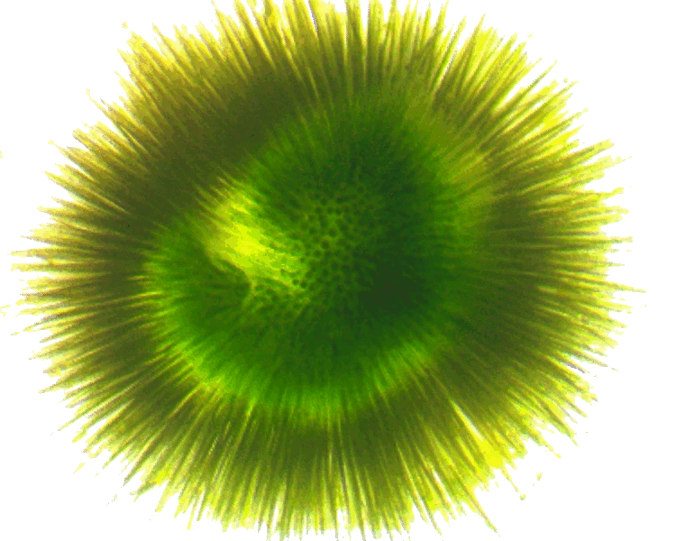
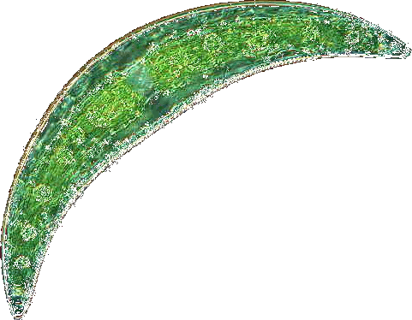


Phytoplankton community composition and cyanotoxin detection among lakes included in the 2007 National Lake Assessment
Betty J. Kreakie¹ , W. Bryan Milstead¹, Jeffrey W. Hollister¹, Elizabeth D. Hilborn¹, & Keith A. Loftin²
Ecological Society of America
August 2017
¹U.S. Environmental Protection Agency
²U.S. Geological Service

Slide 2

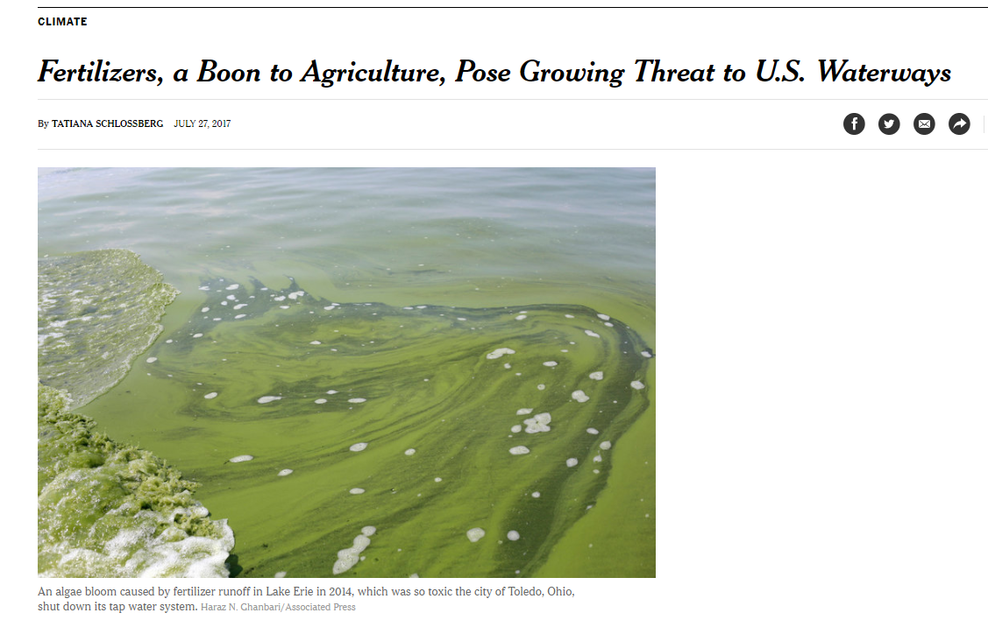

Slide 3



http://science.sciencemag.org/content/357/6349/350.full
http://science.sciencemag.org/content/357/6349/405.full

Slide 4
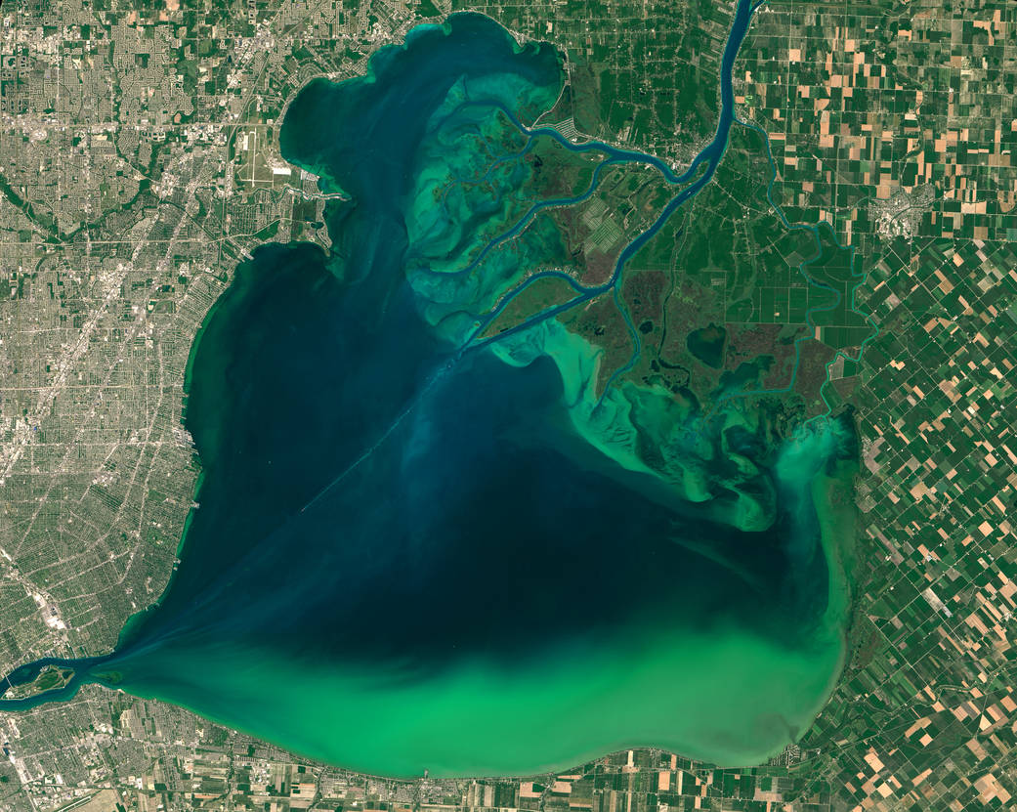
Blooms vs. Toxins?
Notes:
Not just agriculture-other anthropogenic sources also important
N, P, temperature, storms, morphometry, landscape
Blooms are part of the story- Toxicity also important.

Slide 5
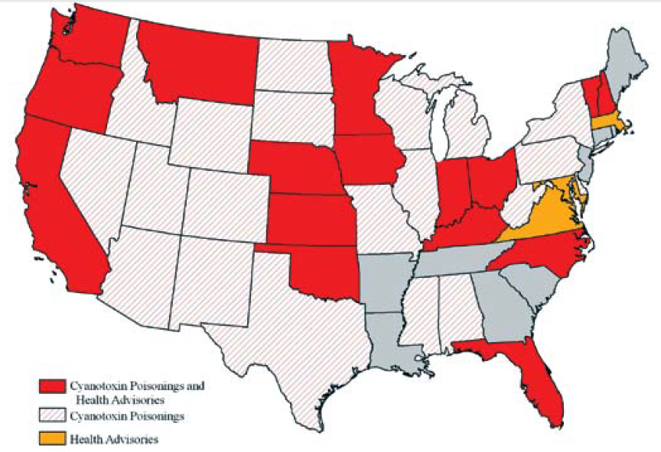
At least 36 States and 50 Countries have reported cyanotoxin poisonings
Graham et al 2009 http://ks.water.usgs.gov/studies/qw/cyanobacteria/LLsummer-graham2.pdf

Slide 6
Cyanotoxins and Potential Producers
From: Loftin, et al. (2016). Harmful Algae 56: 77-90. http://dx.doi.org/10.1016/j.hal.2016.04.001

Slide 7
EPA Health Advisory Concentrations for Microcystins and Cylindrospermopsin
Drinking water health advisory:
Microcystin: 1.6 µg/L adults; 0.3 µg/L preschool children
Cylindrospermopsin: 3 µg/L adults; 0.7 µg/L preschool children
EPA, Office of Water, 820F15003, June 2015
Recreational Ambient Water Swimming Advisories (draft):
Microcystins: 4 µg/L
Cylindrospermopsin: 8 µg/L
“If used as a swimming advisory to protect swimmers at a beach, these values are not to be exceeded on any single day”
EPA, 822-P-16-002, December, 2016

Slide 8
Goal:
To understand the relationship between phytoplankton community structure, cyanobacteria abundance, and the occurrence of cyanotoxins in lakes.
Questions:
Are there identifiable phytoplankton community types across the coterminous United States?
Is cyanotoxin level or detectability related to phytoplankton community type?
What are the environmental or biotic determinants of community type?

Slide 9
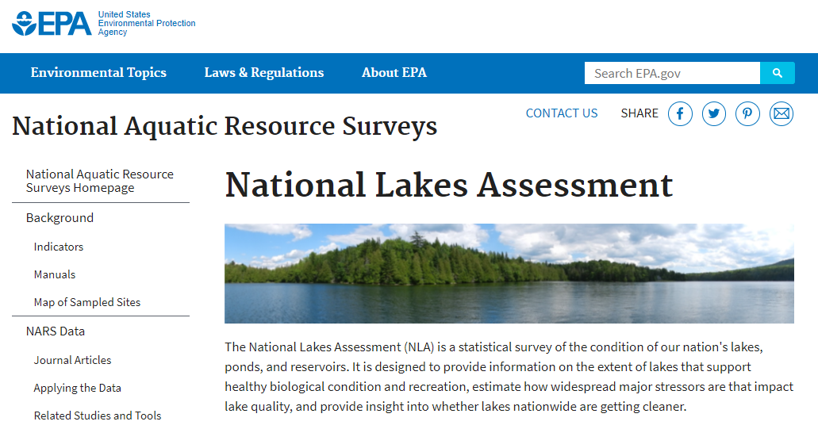
Data Sources
https://www.epa.gov/national-aquatic-resource-surveys/nla
Data from the 2007 National Lake Assessment.
1148 lakes with complete physical, chemical and biological data selected for analysis.
Phytoplankton identified to genus and enumerated
Total sample cyanotoxin (microcystin, saxitoxin, cylindrospermopsin) concentrations measured by ELISA (Loftin et al 2015 http://dx.doi.org/10.3133/ds929)
Data from the 2012 National Lake Assessment.

Slide 10
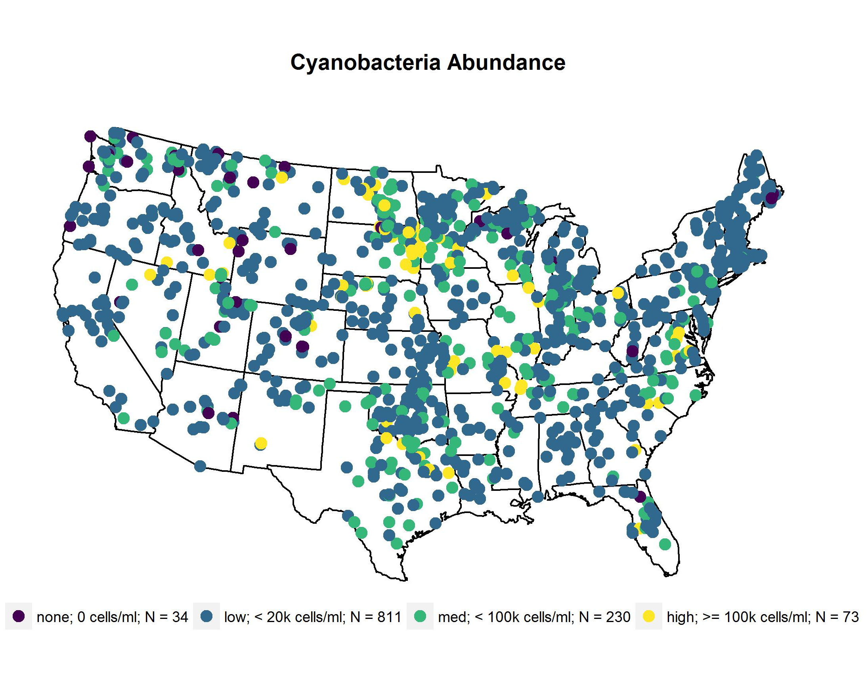
Sample Sites

Slide 11







Methods - Analysis
Genus level phytoplankton abundances analyzed by non-metric multidimensional scaling (NMDS)with R and metaMDS procedure in the Vegan Package
Cluster analysis used to define lake groupings with vegdist procedure (vegan) and hclust (stats)
Indicator species analysis the indval procedure (labdsv)
All analyses done in the R computing environment with R-studio and github.
Analyze 2007 data first and generate hypotheses to test with the 2012 data.

Slide 12
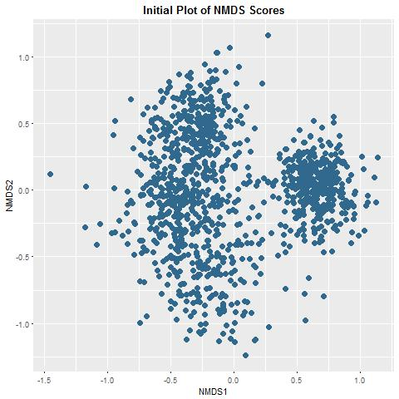
Non-Metric Multidimensional Scaling Analysis
Of Phytoplankton Abundances (Genera)
R Vegan Package: metaMDS Procedure
Wisconsin Square Root Transformation
Data Centered, Scaled, and Rotated
10,000 runs with random starts
4 Dimensions
Failed to converge
Stress = 0.178
N = 1148 lakes

Slide 13
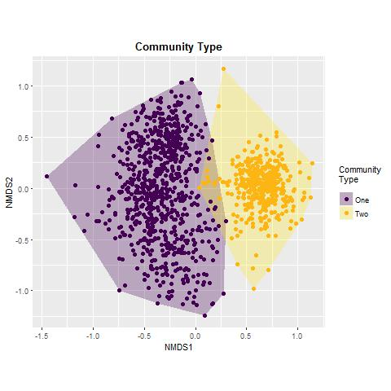
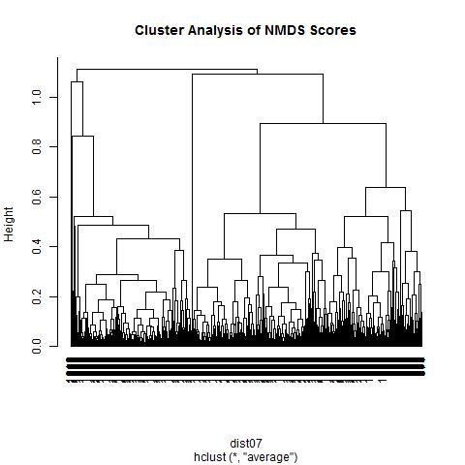
Cluster Analysis of NMDS Scores to Define Logical Grouping of the Data
2
1
1

Slide 14
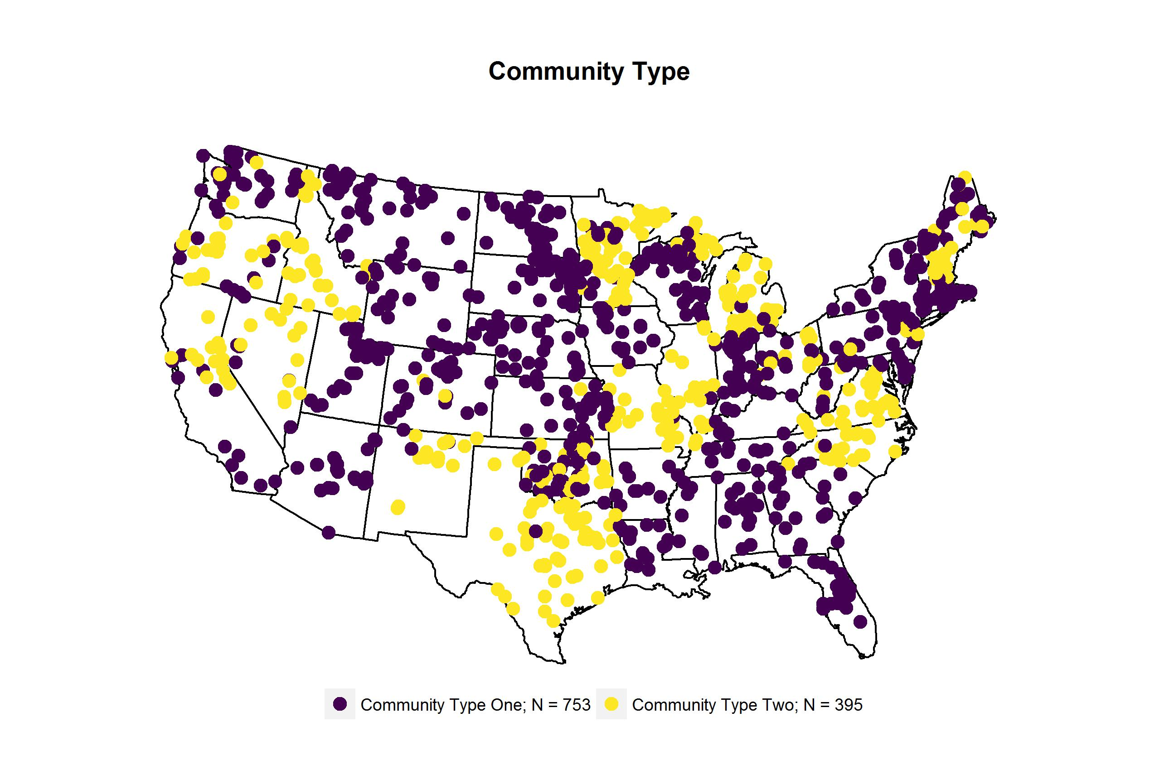
Two High Level Groups Defined and Mapped

Slide 15
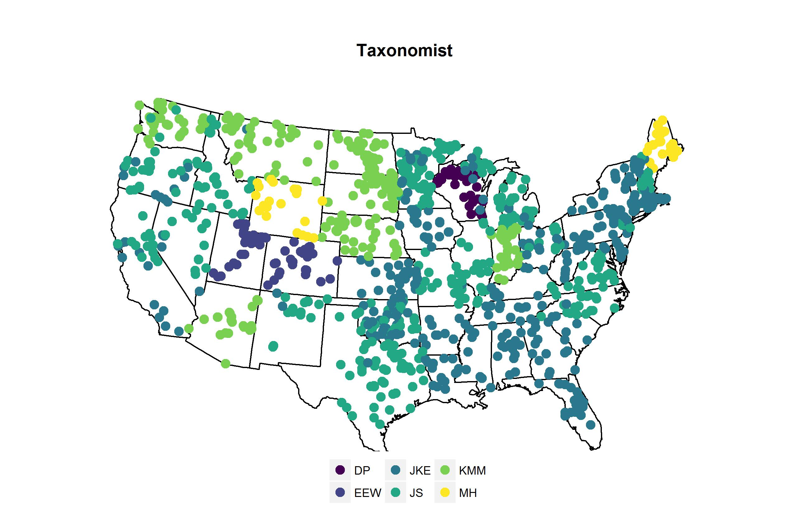
As a QC Check We Mapped the Taxonomist Also
Something is not right

Slide 16
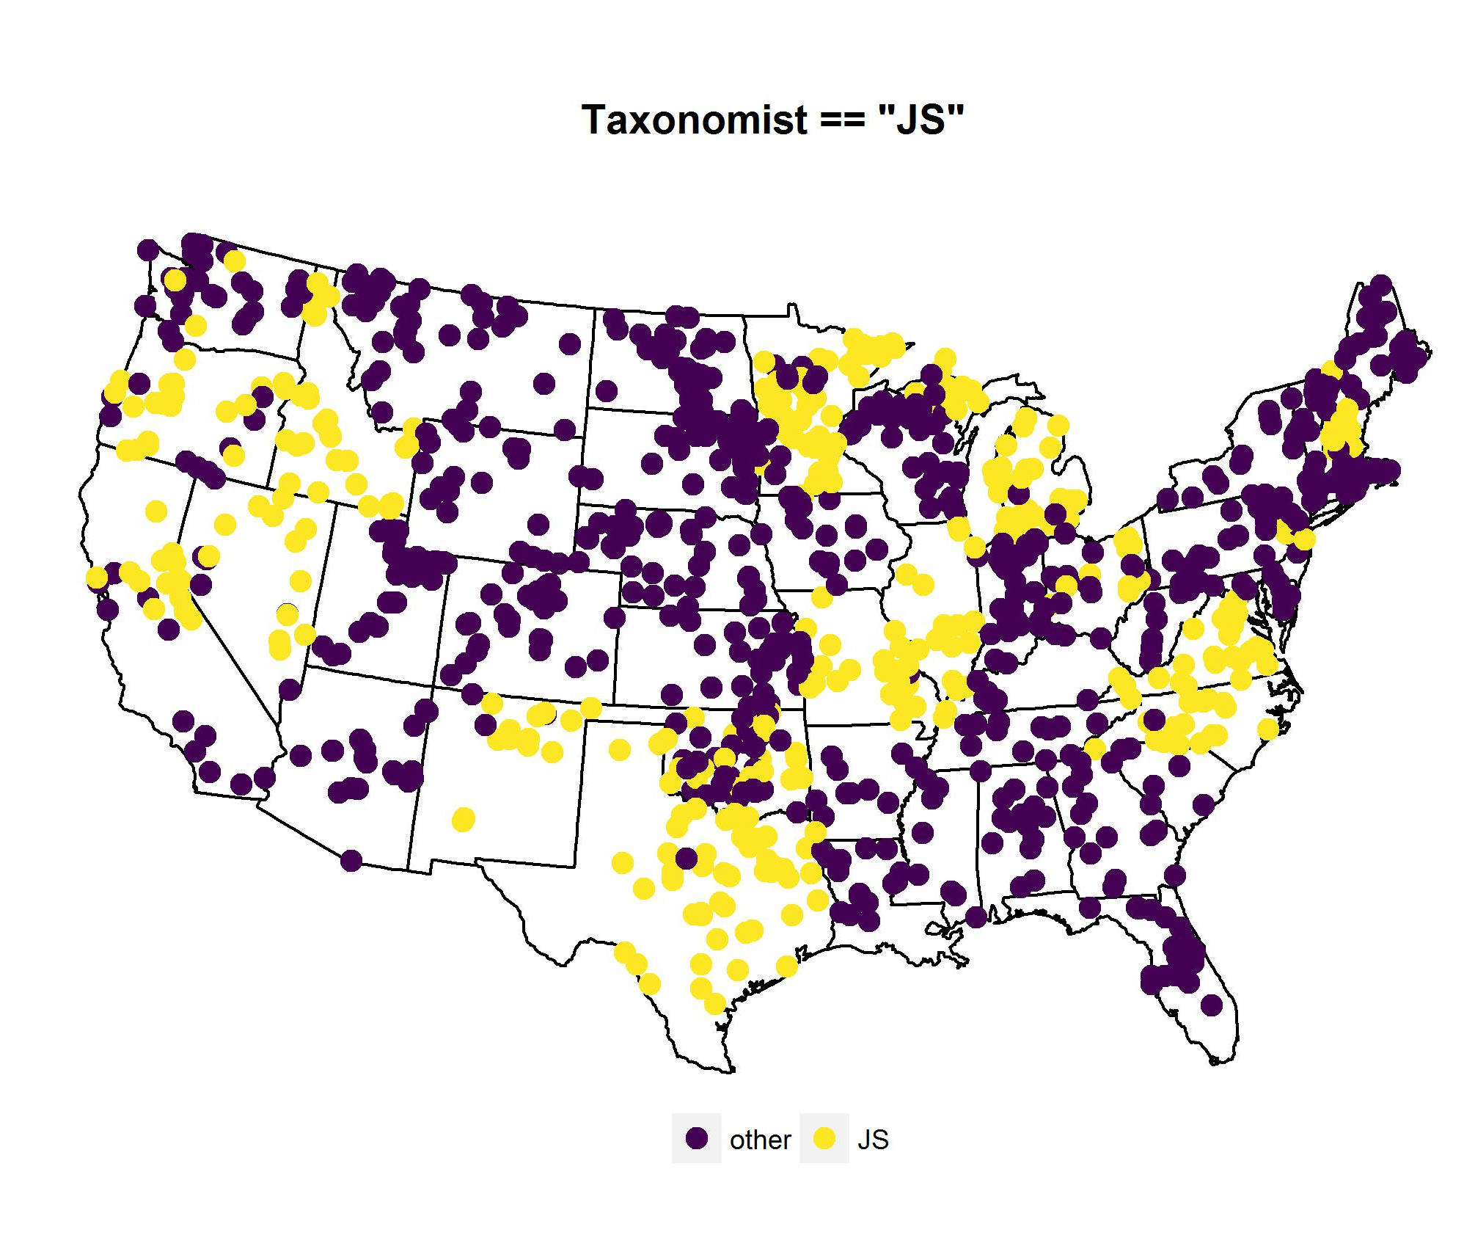
One Taxonomist Stands Out
Something is not right

Slide 17
Non-Metric Multidimensional Scaling Analysis
of Phytoplankton Abundances (Genera)

Slide 18
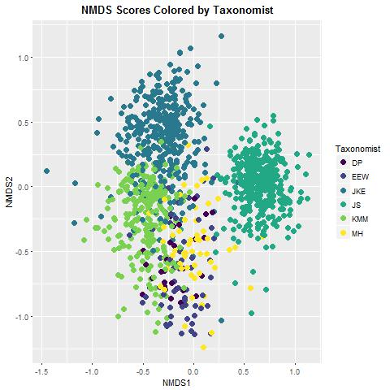
Preliminary Result: The Strongest Signal in the Data is the Taxonomist Who Identified the Phytoplankton

Slide 19
Preliminary Result: The Strongest Signal in the Data is the Taxonomist Who Identified the Phytoplankton
Possible Explanations
Different taxonomies
Non-random sample allocation
Spatial gradients
Environmental gradients
Temporal gradients
Difficulties with some taxa or morphometric forms
Filamentous cyanos
Heteroconts
Picoplankton
Rare species
Preservation methods

Slide 20
Preliminary Result: The Strongest Signal in the Data is the Taxonomist Who Identified the Phytoplankton
Next Steps
Check the QA/QC work of the 2007 NLA phytoplankton dataset
Imagery
Repeated counts
Work with a taxonomist to harmonize taxonomic differences
Look for spatial, environmental, or temporal gradients in lakes assigned to taxonomists
Identify which taxonomic groups differ between taxonomist
Work at higher or hierarchical taxonomic levels
Review the 2012 NLA data for differences among taxonomists

Slide 21
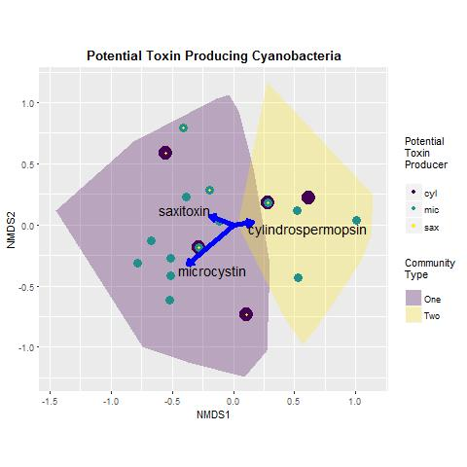
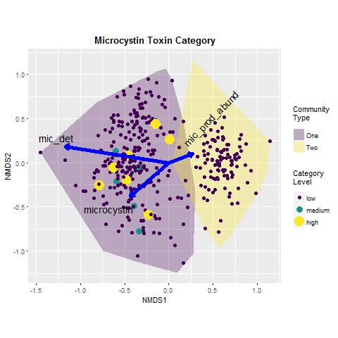
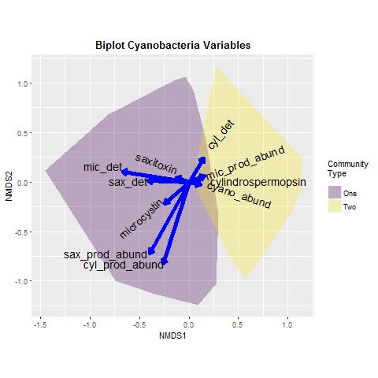
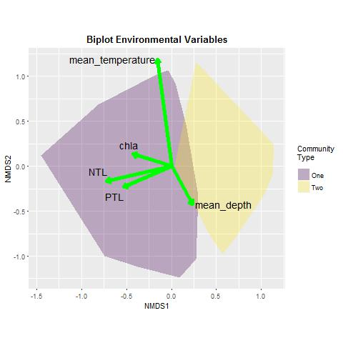
The Original Story we No Longer Have Confidence to Support
Notes:
This is the story we wanted to tell.

Slide 22
Thank You
Bryan Milstead
U.S. Environmental Protection Agency
Narragansett RI
milstead.bryan@epa.gov
401-782-3015
Notes:
Not just agriculture-other anthropogenic sources also important
Blooms are part of the story- Toxicity also important.

Slide 23
Conclusion: The Strongest Signal in the Data is the Taxonomist Who Identified the Phytoplankton

Slide 24


Lessons Learned
Taxonomy matters
Don’t trust constructed reality (don’t believe everything models tell you)
Don’t be swept away by the story
Script all analyses
Reproducible Research
Open Data and Code
Version Control and Code Repositories
Literate Programming

Slide 25
Next Steps:
Work with a phycologist to clean up the 2007 National Lake Assessment phytoplankton data
Repeat analysis at various taxonomic levels
Look carefully at the recently released 2012 National Lake Assessment phytoplankton data
Publish these results as a cautionary tale.

